Slide 1
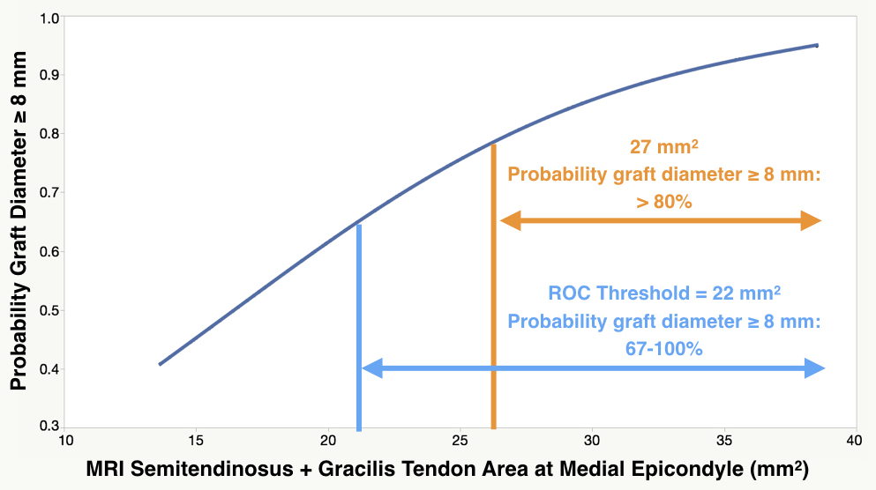
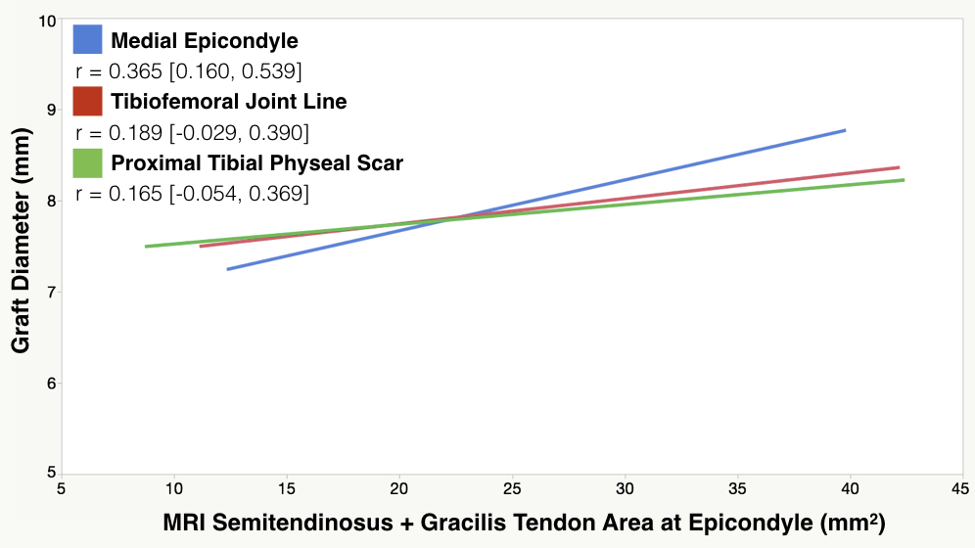
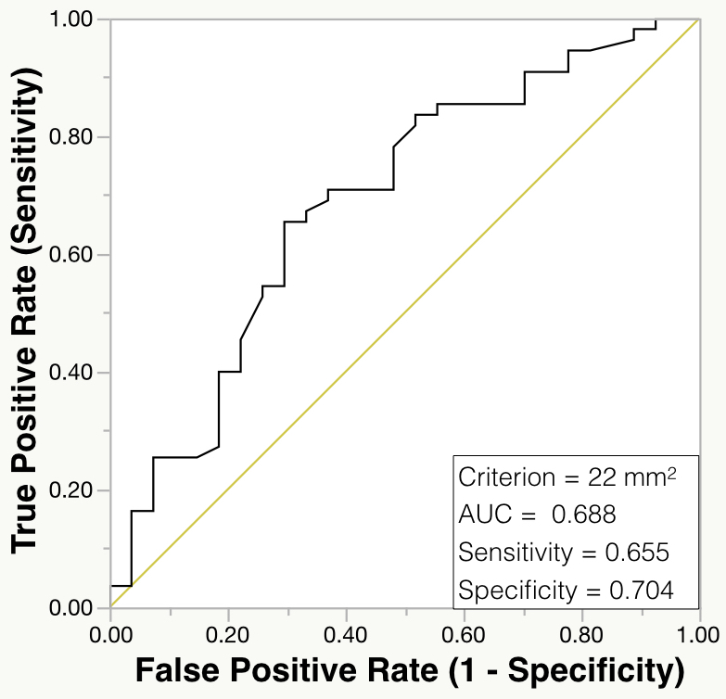
Optimal Location for Measuring the Cross-Sectional Area of Hamstring Tendons on Preoperative MRI to Best Predict ACL Graft Diameter in Adolescent Patients
Clayton Hodges, MD¹; Trevor Shelton, MD, MS¹; Cyrus Bateni, MD²; Steve Henrichon, MD²; Alton Skaggs, BS³; Robert Boutin, MD²;
Richard Marder, MD¹; Cassandra Lee, MD¹; Brian Haus, MD^{1, 4}
University of California, Davis, Sacramento, CA ¹ Department of Orthopaedic Surgery, ² Department of Radiology, ³ School of Medicine, ⁴ Shriners Hospital for Children, Sacramento, CA
OBJECTIVES
It is well recognized that a graft diameter ≥ 8 mm is optimal for successful ACL reconstruction. Pre-operative measurement of gracilis tendon (GT) and semitendinosus (ST) cross-sectional area using MRI has been advocated.
The purposes of this paper were to examine the cross-sectional areas of the hamstring tendons at different locations about the knee and develop a model that would accurately predict if a doubled hamstring graft comprised of ST and GT will be of sufficient cross sectional area to be used for ACL reconstruction.
RESULTS
Figure 1: The medial epicondyle had a significant correlation to graft size compared to the tibial physis (p = 0.044) and trended towards a stronger correlation as compared to the joint line (p = 0.076). There was no difference in correlation between the joint line and the tibial physis (p = 0.815).
Figure 3: The best cutoff threshold for balancing sensitivity and specificity was 22 mm². A combined cross-sectional area ≥ 22 mm² results in a ≥ 67% probability that the hamstring autograft will be ≥ 8 mm while a combined cross-sectional area ≥ 27 mm² results in a > 80% probability of a hamstring autograft being ≥ 8 mm in adolescent patients (Figure 3).
Location | Interobserver Reliability (ICC)
Medial Epicondyle | 0.665
Tibiofemoral Joint Line | 0.694
Tibial Physeal Scar | 0.643
METHODS
82 patients ≤ 18 years of age who underwent ACL reconstruction from January 2010 to December 2016 using an autogenous, doubled hamstring graft were identified
Measured combined cross-sectional area of GT and ST on axial MRI at three locations: 1) medial epicondyle, 2) tibiofemoral joint line, and 3) proximal tibial physeal scar
Intraclass correlation (ICC) determined inter-observer reliability of measurements
Pearson’s correlation coefficient (r) determined correlation of intra-operative graft size to combined cross-sectional area of GT + ST
Previously described statistical methods compared correlation coefficients from each of the three levels
A receiver operating characteristic (ROC) was used to establish a cutoff threshold that would predict a graft size ≥ 8 mm
DISCUSSION & CONCLUSIONS
Surgeons performing ACL reconstruction should be aware that the best cutoff threshold to balance sensitivity and specificity is a combined cross-sectional area of 22 mm² at the medial epicondyle in adolescent patients. Combined cross-sectional area measurements greater than 27 mm² at the medial epicondyle showed a greater than 80% probability of predicting a doubled hamstring autograft diameter ≥ 8 mm.
Figure 2: The area under the curve of the ROC curves was highest at the medial epicondyle (AUC = 0.688) compared to the joint line (AUC = 0.577) and the tibial physis (AUC = 0.568) indicating the medial epicondyle has a better predictive value for the ROC curve to determine whether the hamstring autograft size is ≥ 8 mm based on the combined cross-sectional area of the GT + ST compared to the joint line or the tibial physis in adolescent patients.
Contact Information: awskaggs@ucdavis.edu

